Slide 1
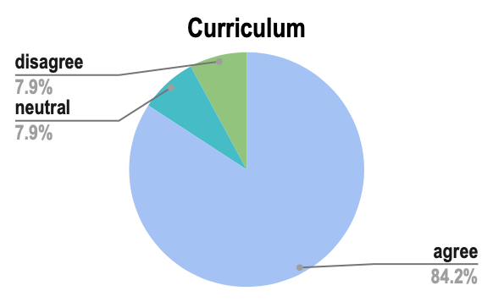
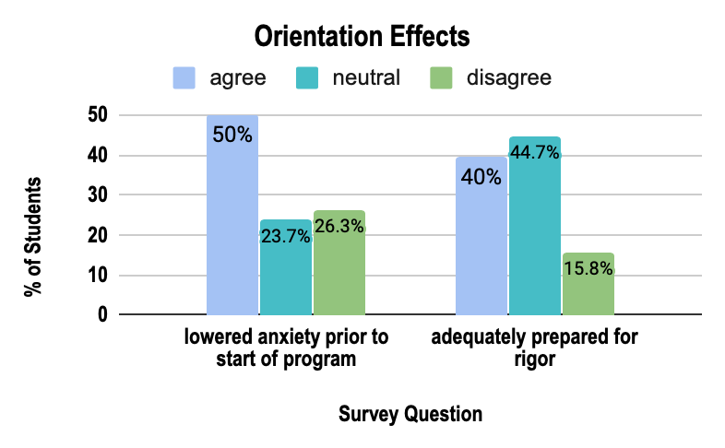
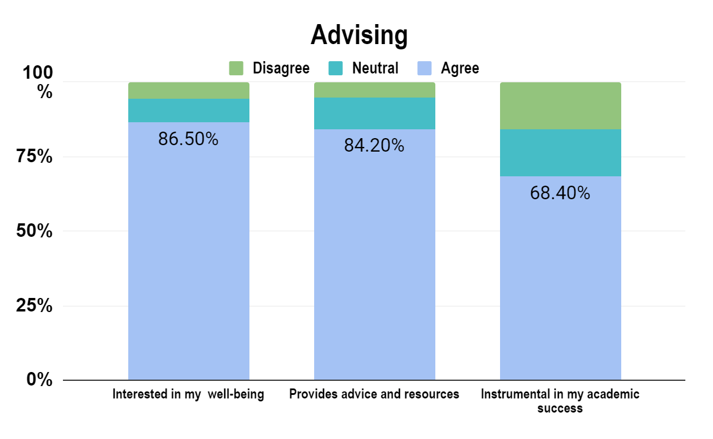
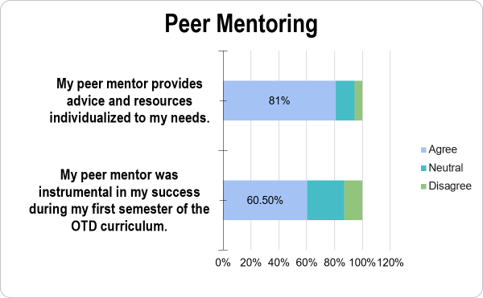
An Investigation of the Doctor of Occupational Therapy Students at the University of Mississippi Medical Center: Well-being
Arinder, G., OTS, Brooks, C., OTS, Cochran, D., OTS, Kennamer, S., OTS, Miles, H., OTS, Smith, M., OTS, Sullivant, S., OTS, Giroux, P., PhD, MHS, OTR/L, FAOTA, and Parish, R., DHA, MA, OTR/L, CHT
School of Health Related Professions l Department of Occupational Therapy
University of Mississippi Medical Center l Jackson, MS
Factors Affecting Well-Being
ABSTRACT
RESULTS
METHODOLOGY
Purpose: The purpose of this study was to explore the factors (curriculum, orientation, advising/peer mentoring, and transitioning) that affect the well-being (the state of being happy and healthy) of UMMC OTD students during their first summer semester.
Methods: A mixed-methods cross-sectional survey was utilized to assess the students' perspectives of their well-being in respect to multiple elements of both the academic program and their personal life.
Results: Thirty-eight students participated in the electronic survey. 84.2% of participants either agreed or strongly agreed with being overwhelmed by the academic course load during the first semester of the program. 50% of the participants agreed that the orientation process lowered their anxiety prior to starting the program. 68.4% and 60.5% found that advising and peer mentoring was instrumental to their success, respectively. 57.9% agreed that their undergraduate education prepared them for the coursework. The top three positive effects and opportunities for improvement in orientation, advising, peer mentoring, transition, and curriculum were identified in the Doctor of Occupational Therapy program at the University of Mississippi Medical Center.
Conclusion: There are multiple aspects in place within curriculum, orientation, advising/peer mentoring, and the transition that may positively affect the student’s well-being within their first semester.
Curriculum
Orientation
Advising/Peer Mentoring
Transition
Research Design
A cross-sectional research study was designed by researchers to gather quantitative and qualitative data through an email survey of OTD students at UMMC.
Participants
The researchers emailed 39 surveys to a sample of students from the class of 2022. The final sample included 38 participants.
Data Collection and Analysis
Participants selected to take part in this study were sent an email including a cover letter, and a link to the survey. Informed consent was assumed upon receipt of the completed survey. Three investigators used RedCap and Microsoft Excel 2016 to analyze quantitative data, and qualitative research was hand coded by four investigators and analyzed into themes. Qualitative and quantitative data was synthesized to present factors that contributed to well-being of UMMC OTD students. Within those factors were recommendations to the UMMC OTD program with the aim of improving well-being of future UMMC OTD students.
Primary Aim 1
CONCLUSION
In conclusion, this investigation found that students were overwhelmed by the increase in workload during their first semester relative to undergrad workload which led to increasing levels of stress, anxiety and a general decline in well-being. Students reported that opportunities for social engagement with peers and faculty as well as preparation activities embedded within the program had a positive impact on their well-being. Activities to improve student preparedness for the program before the start of the semester as well as providing more time for both student-to-student and student-to-faculty interaction were recommended to the investigators as areas for improvement in future years of the program.
INTRODUCTION
Figure 1: Effects of Curriculum (overwhelmed by academic workload)
Figure 2: Effects of Orientation
In recent years, student well-being has shifted to the forefront of professional and graduate schools’ priorities. Professional and graduate schools are attempting to understand and meet the needs of these students. First-year students in professional programs often deal with a significant amount of stress and self-doubt (Dahlin, Joneborg, & Runeson, 2005; Hughes and Kleist, 2005). A few key components that impact doctoral students’ well-being are curriculum, orientation, advising, peer mentoring, and transition. Students can have difficulty keeping up with the expectations of the curriculum. It is also found that an adequate orientation process fosters a smoother transition. This transition from undergraduate to graduate programs can negatively affect a student's well-being, including self-doubt. A relationship with a faculty advisor and peer-mentor is found to lead to higher satisfaction and improved well-being. Peer mentoring is found to be more successful in affecting well-being than a faculty advisor. This is due to the higher level of comfort felt with a peer. Taking these factors into consideration assist a doctoral program to foster their students' well-being. There is limited research on the well-being of OTD students, so this study's findings will be used to improve the well-being of future students at UMMC.
LIMITATIONS
Self-report bias due to the students over or under reporting
Sampling was utilized creating a small sample size N=38
Lack of reflection or member checks
No pilot study due to use of modified pre-existing survey
Many participants did not offer recommendations
Figure 3: Effects of Advising
Primary Aim 2
Figure 4: Effects of Peer Mentoring
Table 1: UMMC Class of 2022 Recommendations from the Qualitative Data
OT IMPLICATIONS
Recommendations for Improvement
Curriculum | Increase student preparedness for the program prior to entering their first summer semester.
Orientation | Provide more opportunities for interaction with faculty, peers, or other upperclassmen .
Advising/Peer Mentoring | More one on one time with advisor as well as more advisory meetings.
Transition | Recommendations made to curriculum, orientation, advising, and peer-mentoring will aid the overall transition into the doctoral program.
This investigation serves as a quality improvement tool in the occupational therapy doctoral program at the University of Mississippi Medical Center
The goal of increasing a student's well-being could possibly lead to an increase in the confidence needed to be successful in the program
Many occupational therapy programs have yet to transition to the doctoral level, so this investigation can serve as a resource.
The holistic approach is vital for the success of a graduate student as well as an entry-level clinician
These results may serve as an opportunity to delve deeper into student and faculty perceptions of well-being.
PRIMARY AIMS
Primary Aim I: To identify which factors positively and negatively contribute to well-being.
Primary Aim II: To use these findings to offer suggestions and recommendations to the UMMC OTD program for improving the well-being of their future students.
REFERENCES AVAILABLE UPON REQUEST

